Slide 1
BOARDING PASS
Flight Delay Prediction
FLIGHT
B345
GATE
D8
SEAT
Presented by:
29E
Chang HaoYang Chern Cheng
Fu Yanrou
Wan Yiran
Xie Jialin
Notes:
Hi everyone! We are group 5. Our project for this Machine Learning course is Flight Delay Prediction. Our group members are Chang Haoyang, Chern Cheng, Fu Yanrou, Wan Yiran and Xie Jialin.

Slide 2
TABLE OF CONTENTS
01
02
03
INTRODUCTION
EXPLORATORY DATA ANALYSIS
04
MODELLING & PREDICTION
CONCLUSION & LIMITATION
DATA PROCESSING
05
Notes:
Here are the 5 sections that we are going to present our project. Firstly, I will give an introduction of our project. Second, Yiran and Chern Cheng will present the exploratory data analysis. Then Yanrou will introduce the data processing part before Haoyang introduce the modelling and prediction part, finally Yanrou to make a conclusion.

Slide 3
BOARDING PASS
FLIGHT
Introduction
B345
GATE
D8
SEAT
29E
Social Phenomenon & Literature Review
Notes:
Why we choose this topic as our project?

Slide 4




Social Phenomenon
BOARDING PASS
Notes:
People always suffer from flight delay, I'm sure most of us sitting here have personally experienced the inconvenience and frustration caused by flight delays. Flight delay not only brings inconvenience to passengers, but also brings a lot of cost for airlines.

Slide 5
BOARDING PASS
Introduction
Literature Review
According to a 2010 report made by the US Federal Aviation Administration, the economic price of domestic flight delays entails a yearly cost of 32.9 billion dollars to passengers, airlines and other parts of the economy. More than half of that amount comes from the pockets of passengers who not only lose time waiting for their planes to leave, but they also miss connecting flights, spend money on food and have to sleep on hotel rooms while they're stranded.
Notes:
In fact, there are indeed official reports reflecting this issue. According to a 2010 report made by the US Federal Aviation Administration, the domestic flight delays have caused a yearly cost of 32.9 billion dollars to economy.

Slide 6
BOARDING PASS
Introduction
Literature Review
Forecasting flight delays is a valuable tool in managing the impact of delays on airline operations and passenger experiences. By considering key factors, leveraging data analysis, weather forecasting, and predictive models, and collaborating among industry stakeholders, more accurate and timely delay forecasts can help airlines, airports, and passengers make informed decisions and mitigate the effects of flight delays. However, it is important to recognize the inherent challenges and limitations in forecasting and adapt strategies accordingly to ensure efficient and reliable air travel.
Notes:
Therefore, our project topic is to forecast flight delay, this will be helpful to manage the impact of delays on airline operations and also passenger experience.

Slide 7
MAIN OBJECTIVES: 1. What is the Situation like? Descriptive& EXPLORATORY Analysis 2.What affects flight delay? Feature Importance 3.Predict flight delay Performance of different algorithms(out of sample prediction accuracy)
BOARDING PASS
FLIGHT
B345
GATE
D8
SEAT
29E
Notes:
Here are our main objectives. First, figure out what is the situation like. We get the factors that might influence the flight delay and do descriptive and exploratory analysis. Second, from the analysis, we find out what factors largely affects flight delay.
Last, we use the critical factors to predict flight delay and evaluate the performance of different algorithms that we used. Next, let’s welcome Yiran and Chern to introduce the EDA part.

Slide 8
BOARDING PASS
FLIGHT
Exploratory Data Analysis
B345
GATE
D8
SEAT
29E
Notes:
Here comes to the part of EDA

Slide 9
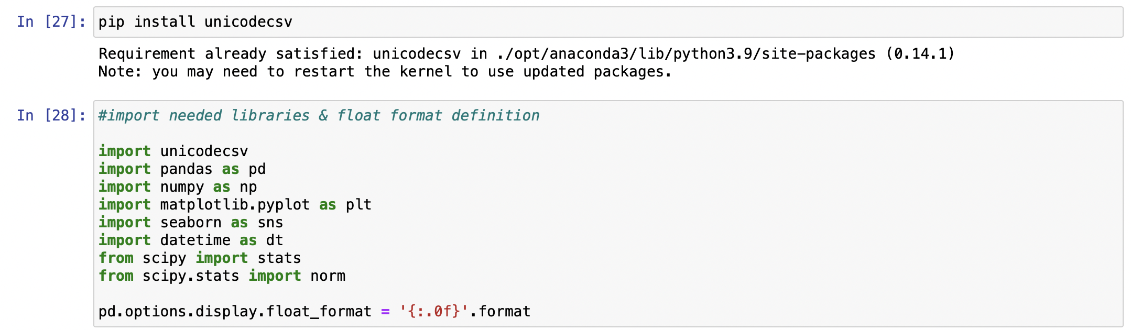
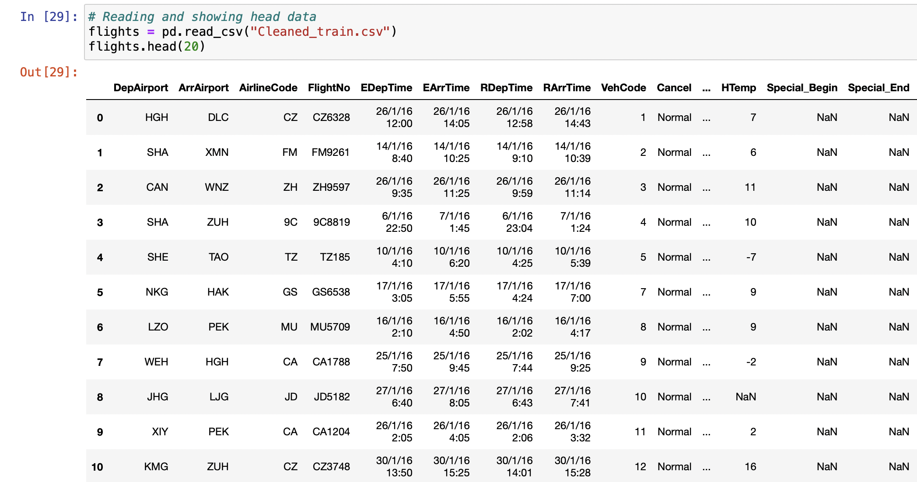
Understanding the structure of the dataset:
JUPITER

Slide 10
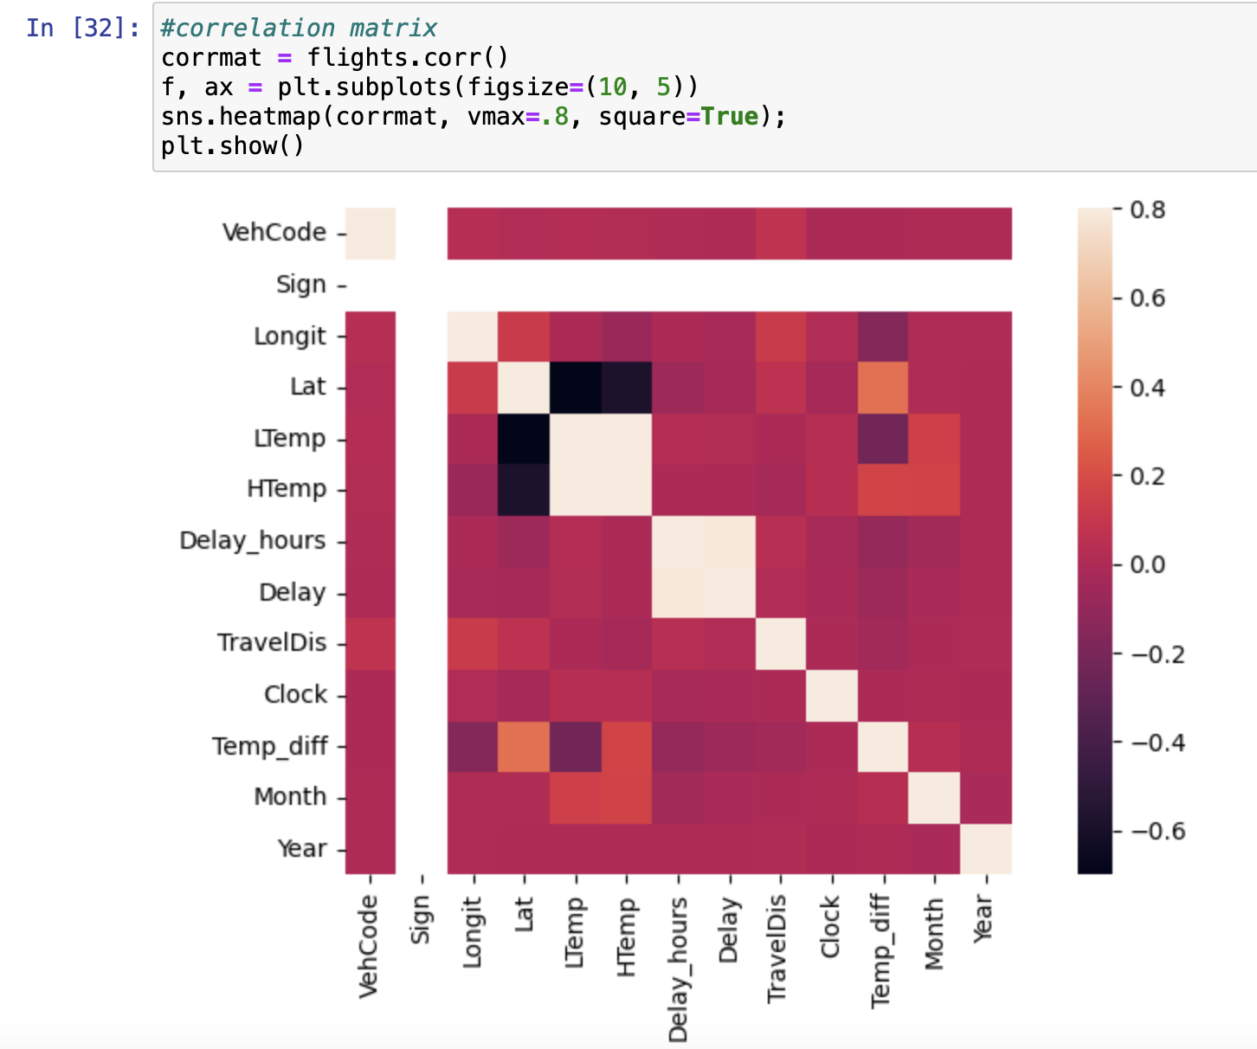
Correlation Matrix
Through the correlation matrix we can see how some of the 13 variables in the dataset present multicollinearity.
In other words, can be linearly predicted from the others. In order to have a better analysis and work with a lighter dataset, we are going to disregard some of those unwanted variables.

Slide 11
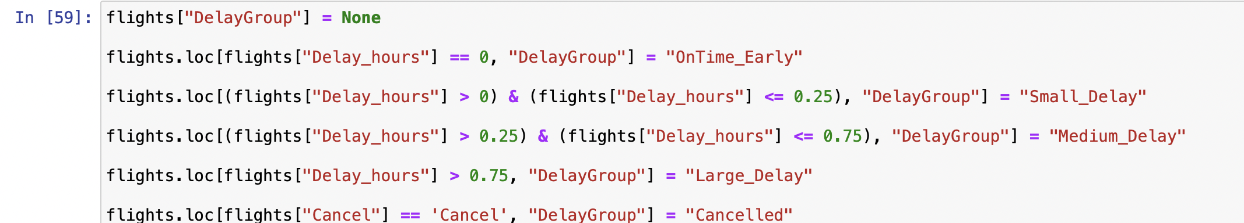
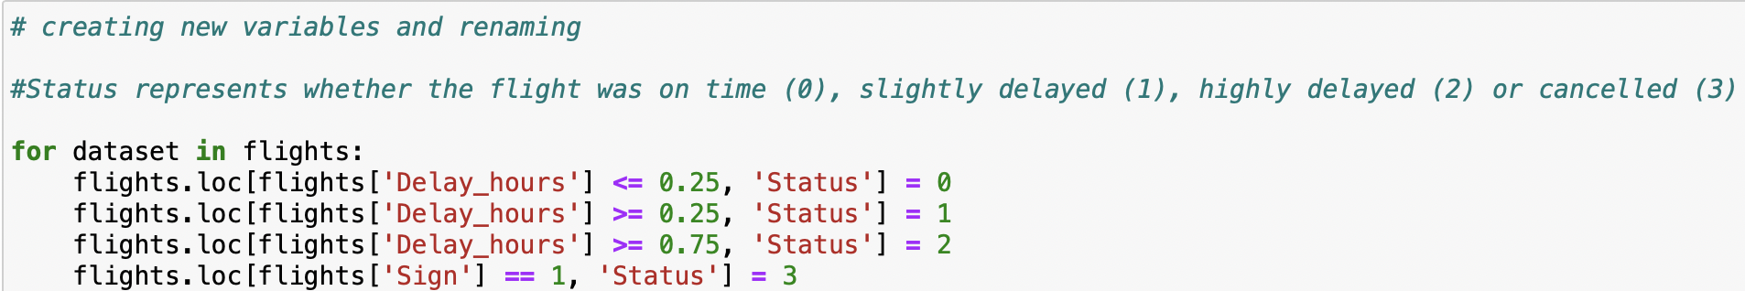
Creating Delay Groups:
Delays are divided into three categories, namely
“On time or small delay" - up to 15 minutes delay
"Medium delay" - 15 – 45 minutes delay
"Large delay" – more than 45 minutes delay.

Slide 12
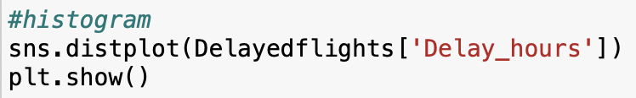
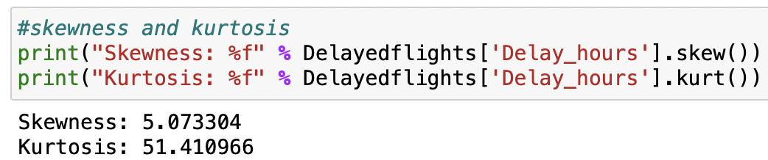
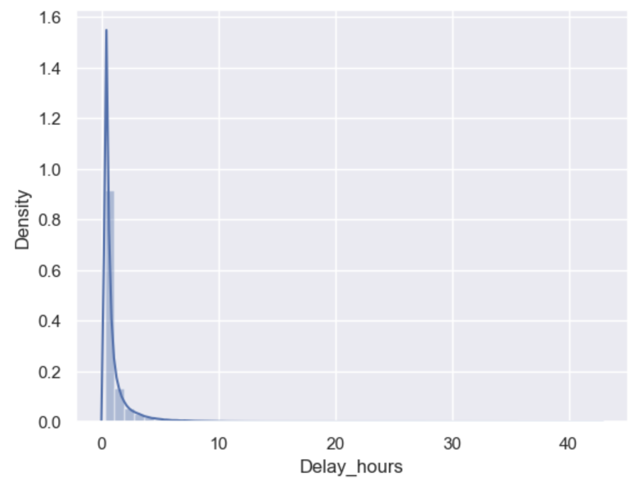
Understanding the Delay_hours (dependent variable)
It can be seen on the histogram and by the skewness and kurtosis indexes, that delays are mostly located on the left side of the graph, with a long tail to the right.
The majority of delays are short, and the longer delays, while unusual, are more heavy loaded in time.

Slide 13
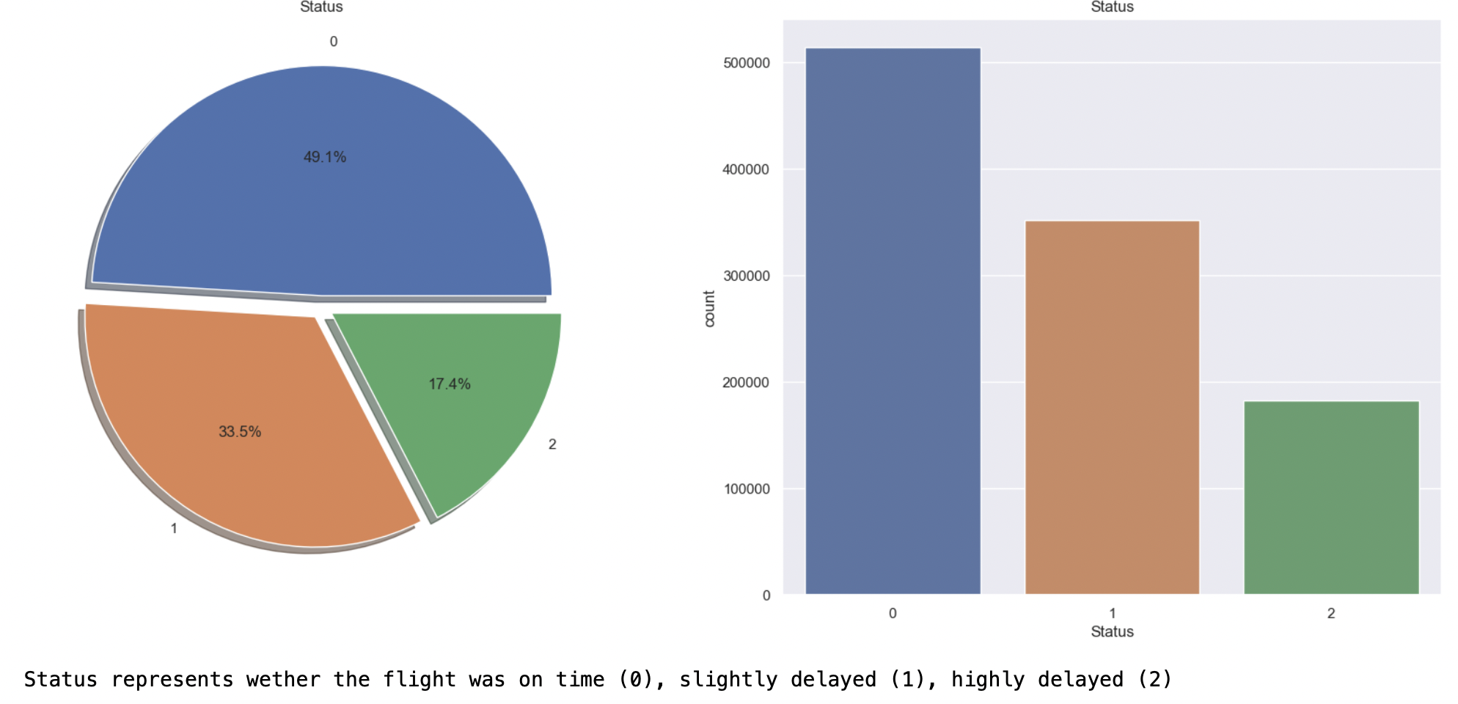
Flight Delay Groups
In 2016, a whooping 50.9% of domestic flights in the China were delayed by more than 15 minutes. 17.4% of total flights had delays of more than 45 minutes!
Another different interpretation is that 82.6% of flights have delay of 45 minutes or less

Slide 14
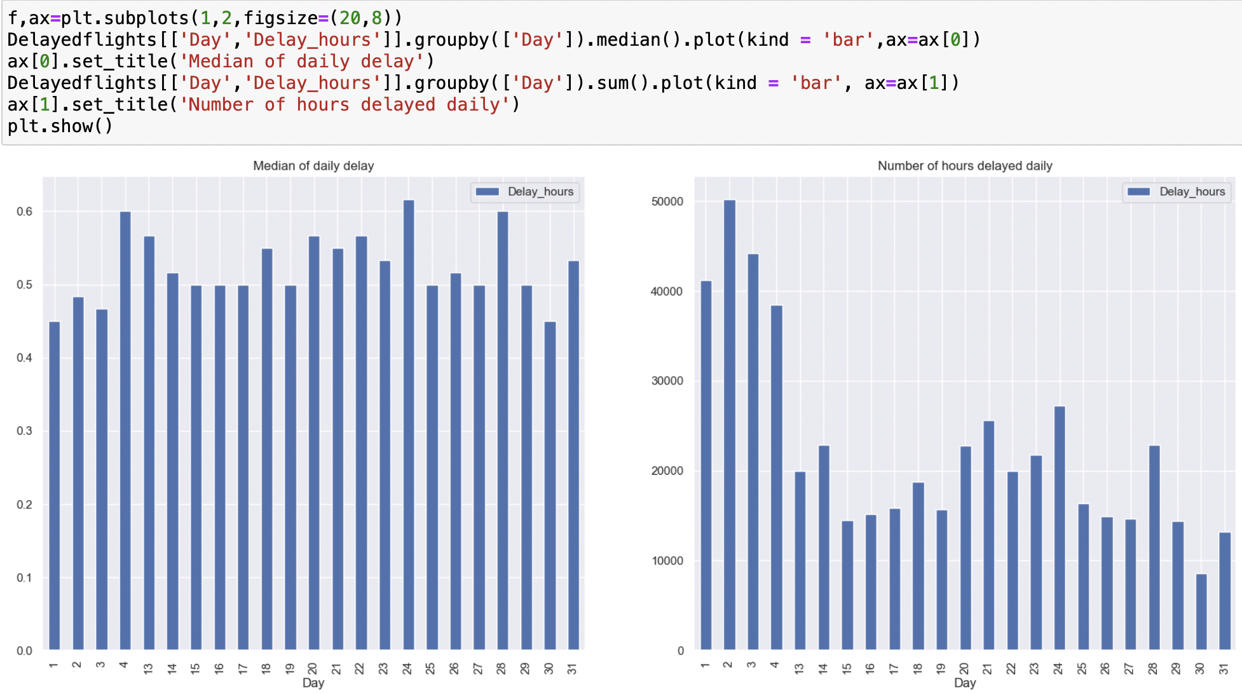
Understanding Delay_hours by Days
Trends shows higher number of delays in first few days of the months followed by occasional spike in between the remaining days of the month
Median of daily delay is evenly distributed.

Slide 15
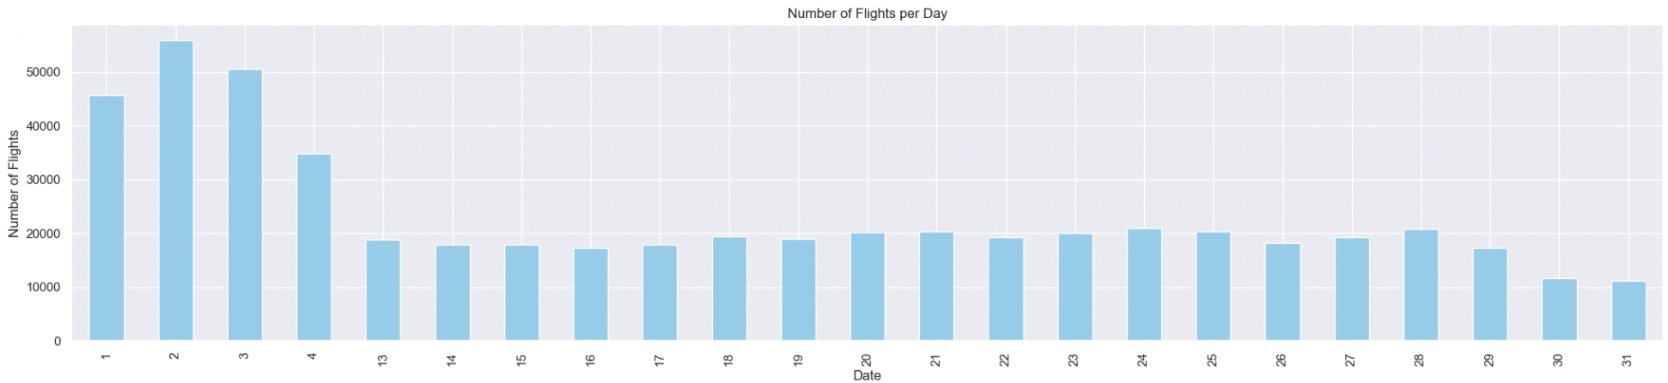
Trends of Monthly/ Daily Flight Numbers
Higher delay hours on days with more flights.

Slide 16
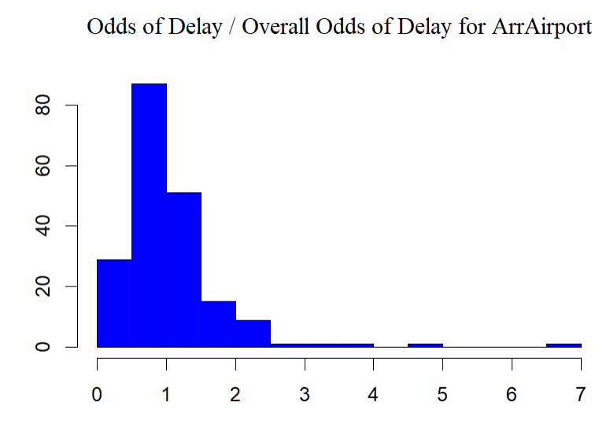
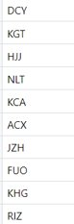
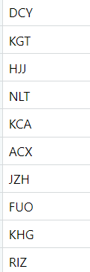
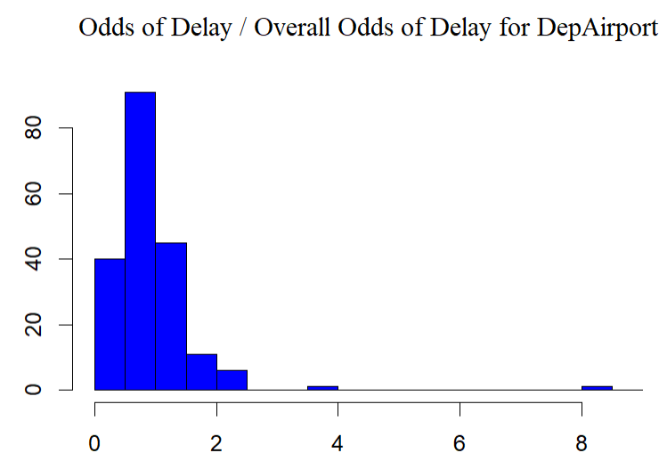
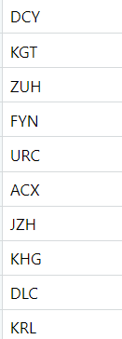
Odds of delay for each Airport
The left shows the distribution for the odds of delay for each airport, and listed the top 10 airports with highest odds of delay
We can see a lot of overlap between two lists. (for arrival airport and departure airport)
The top two with distinguishingly high odds of delay (DCY and KGT) are of an altitude of 4000+ meters.

Slide 17
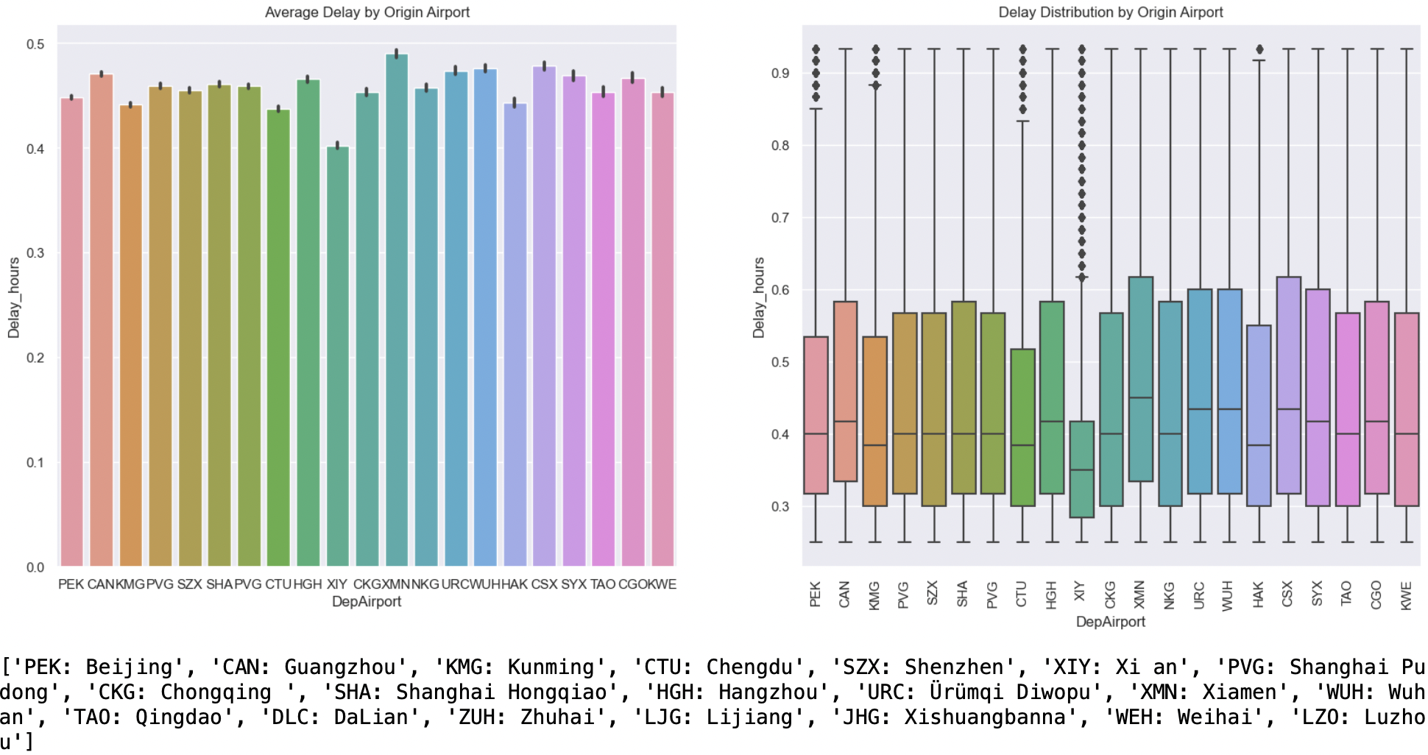
Delay Distribution by Top 20 Airports
Boxplot show relatively low occurrence of delay and low median for XIY (Xi An) airport.
Boxplot interquartile range for the rest of the airport are relatively the same.

Slide 18
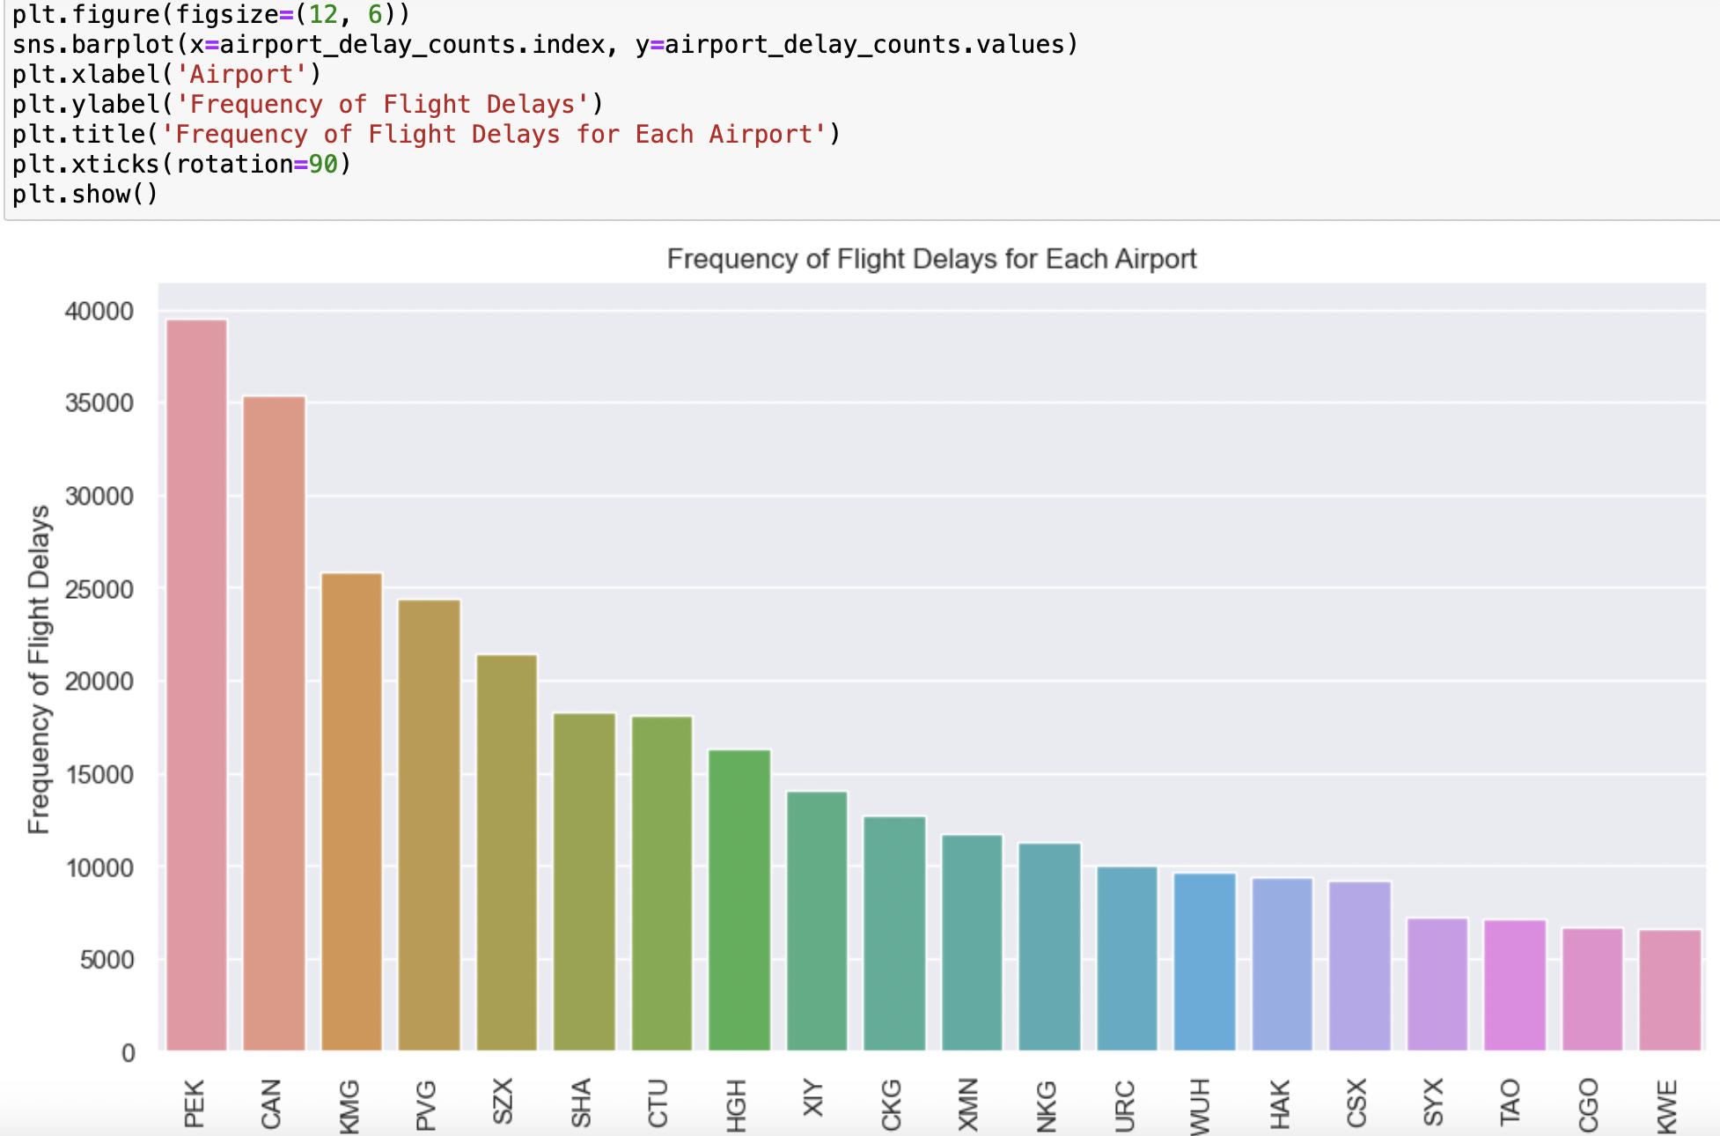
Frequency of Flight Delays for each Airport
Even though the airports have roughly the same median. It can be seen that PEK (Beijing), CAN (Guangzhou) have relatively higher frequency of flight delay as compared to the rest of the airports.
Hence, the median of Delay_hours is not indicative of how frequent the flight delay occurs.

Slide 19
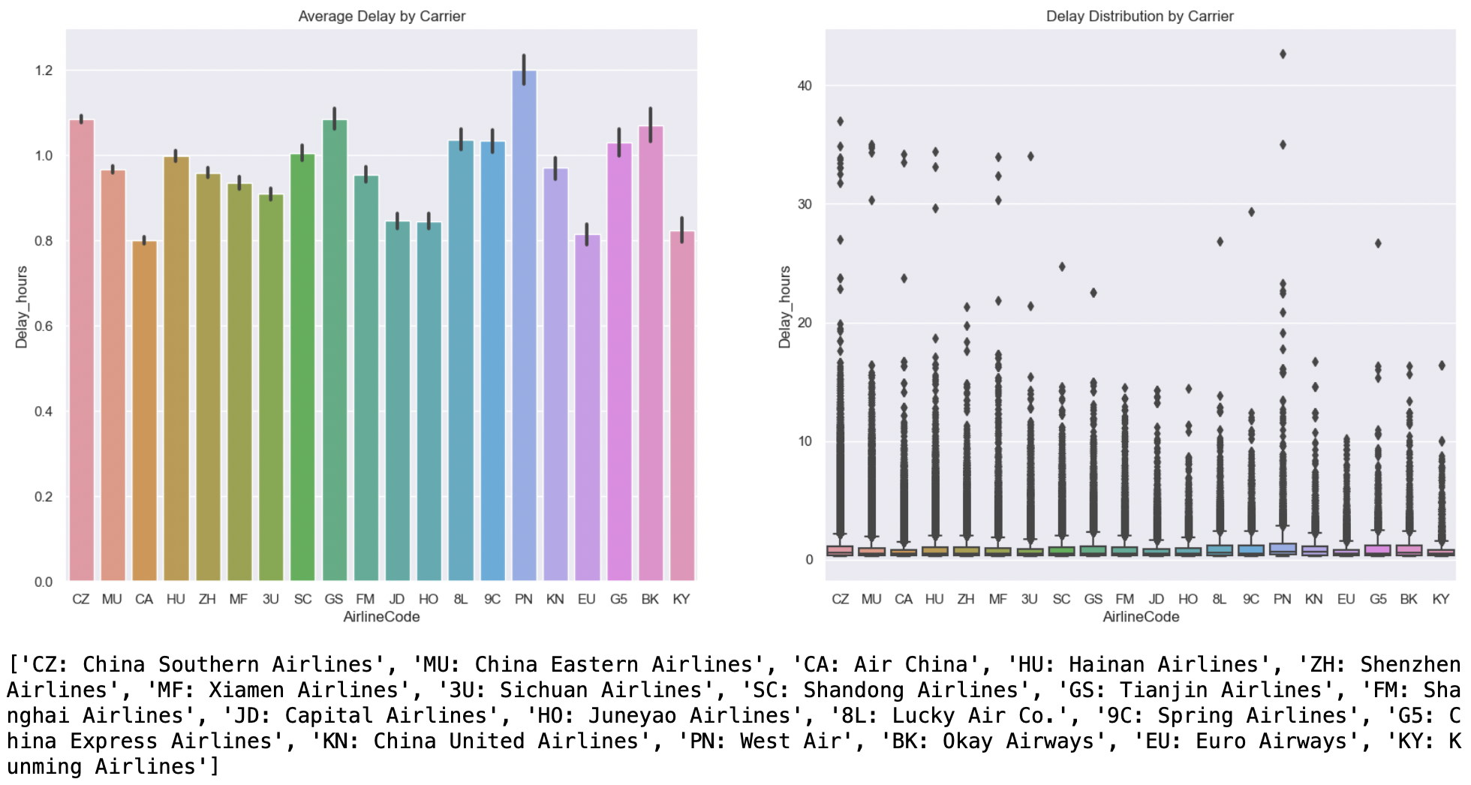
Delay Distribution by Top 20 Airlines
Box plot shows presence of outliers.
Majority of the Delay_hours are small and medium delays.
Large delays are outliers.
Noted there is 58 data points with flight delay hours > 20 hrs. Outlier management is needed

Slide 20
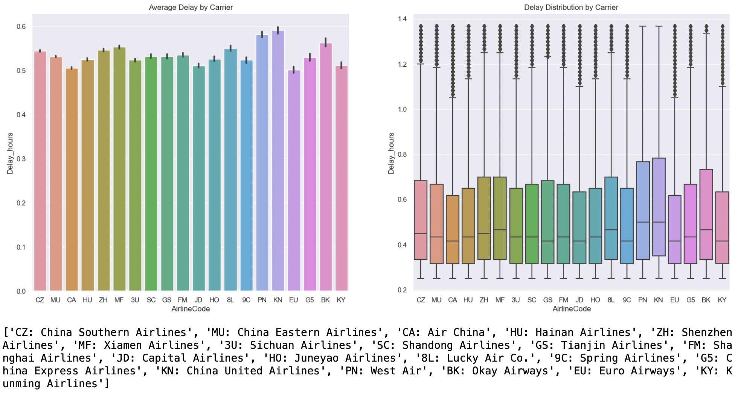
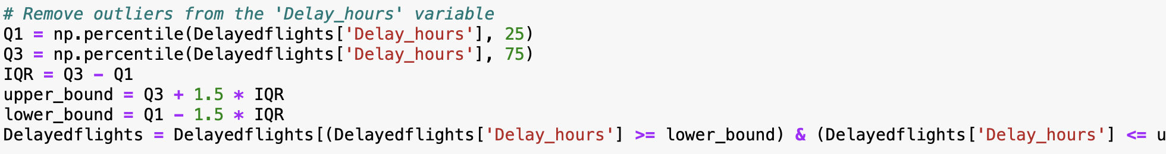
Delay Distribution by Top 20 Airlines (after outlier management)
Extremely large delays are removed.
Median: shows that the central tendency of the delay hours across the airlines are between 0.4 to 0.5 hours.
PN (West Air) and KN (China United Airlines) has the greatest variability (height of box plot -50% of data)

Slide 21
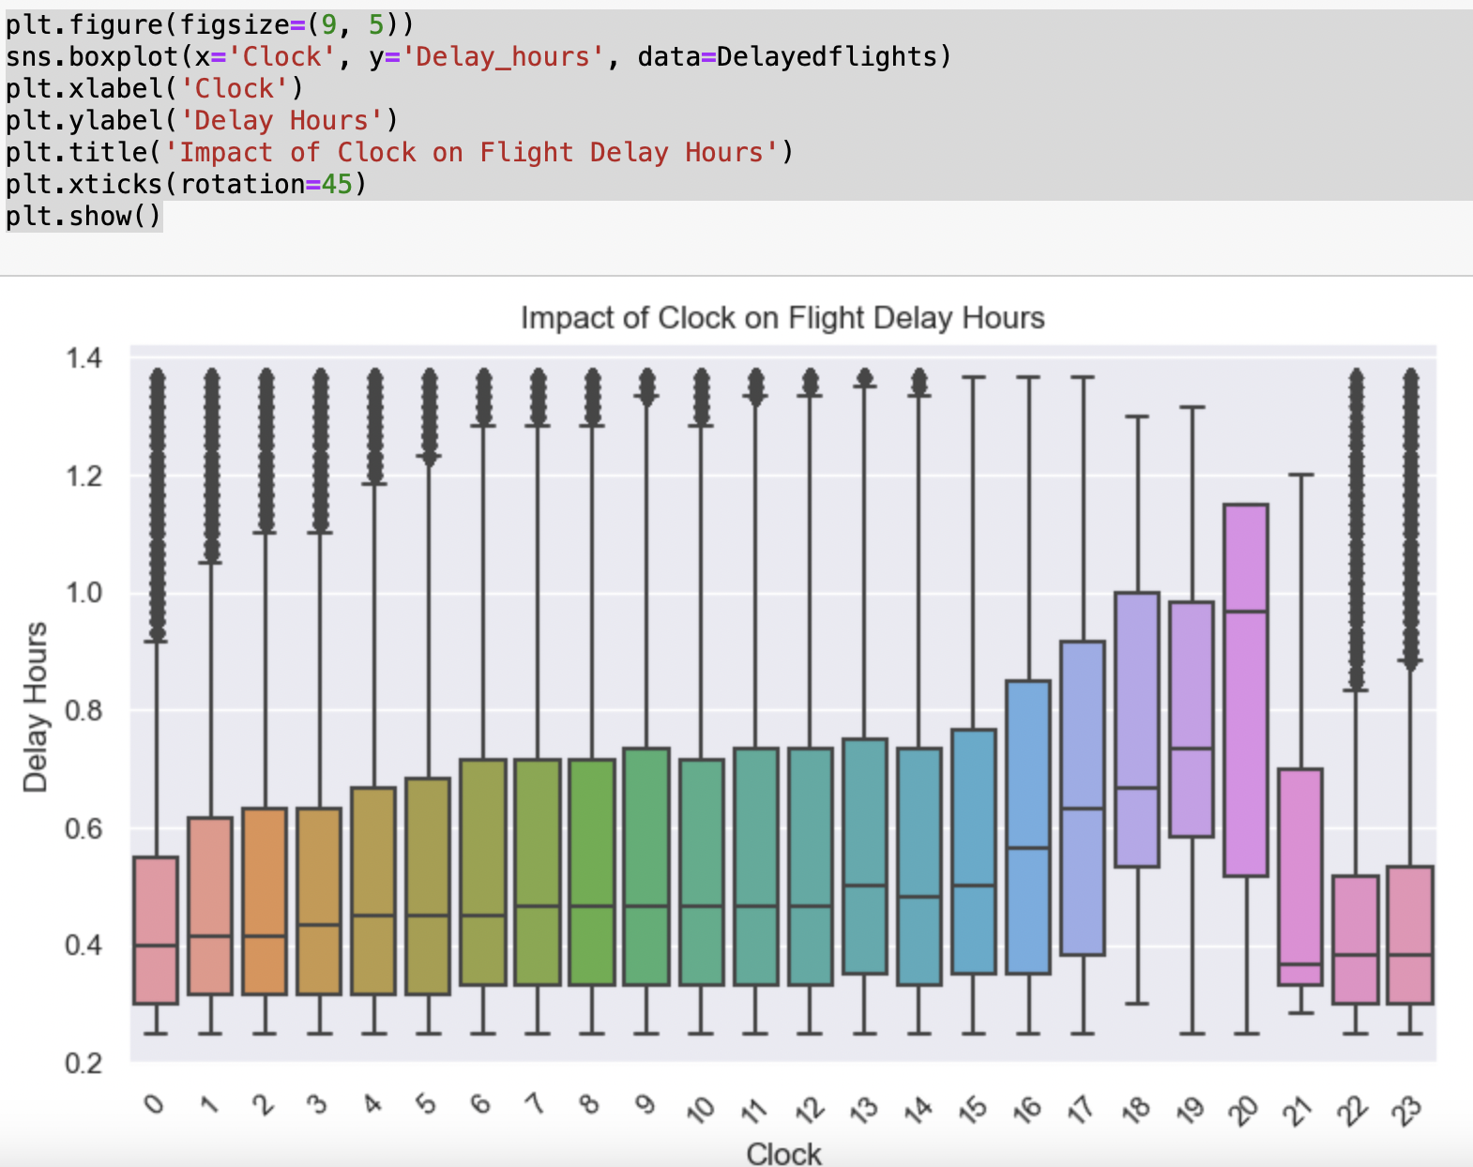
Impact of Clock on Flight Delays
Higher delay hours for certain time of the day (17:00hrs – 20:00hrs)
The boxplot for 20:00hrs has no whiskers. The absence of whiskers indicates that the Delay_hours within the 8pm clock interval are relatively clustered and do not have extreme values. The box plot only displays the whiskers when there are data points that fall beyond the upper or lower bounds, suggesting potential outliers.

Slide 22
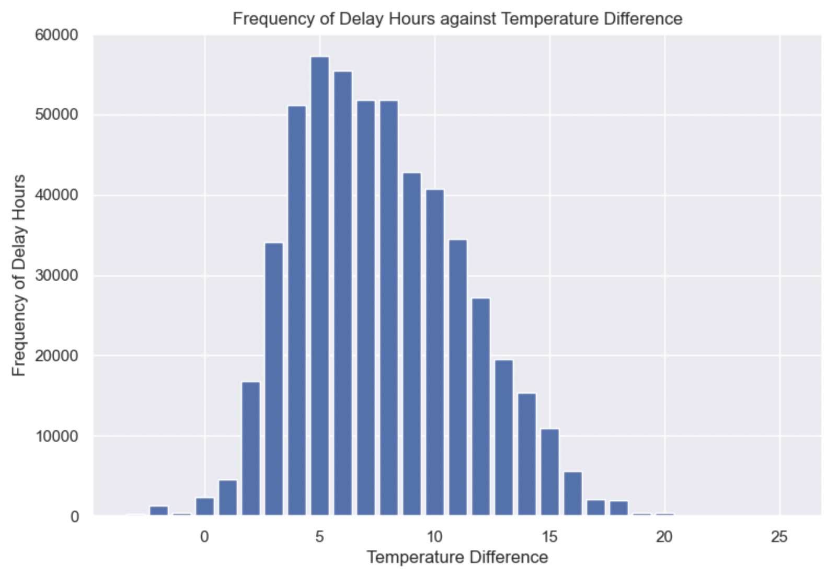
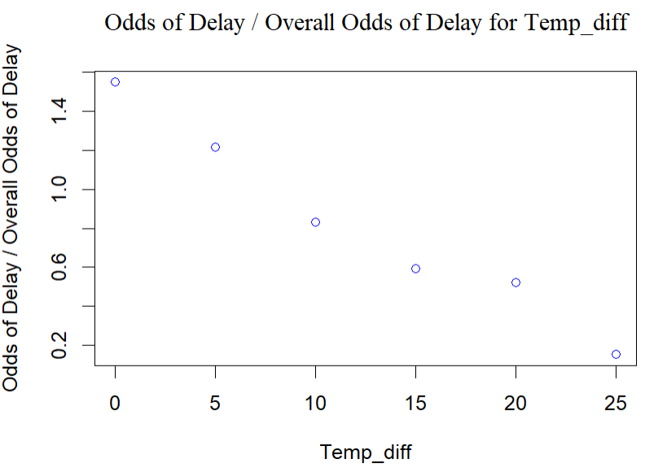
Impact of Temp_Diff on Flight Delays
Higher frequency of Delay for Temp_diff between 4 – 8 degree celsius with the highest at 5 degree celsius
Low Temp_diff indicates extreme weather conditions which can cause higher occurrence of flight delay.
Odds of Delay compared against Temp_diff shows linear relationship. Temp_diff decrease, Odds of delay increase.
Notes:
Frequency of delay is not indicative of whether the likelihood of particular temp diff happening frequently

Slide 23
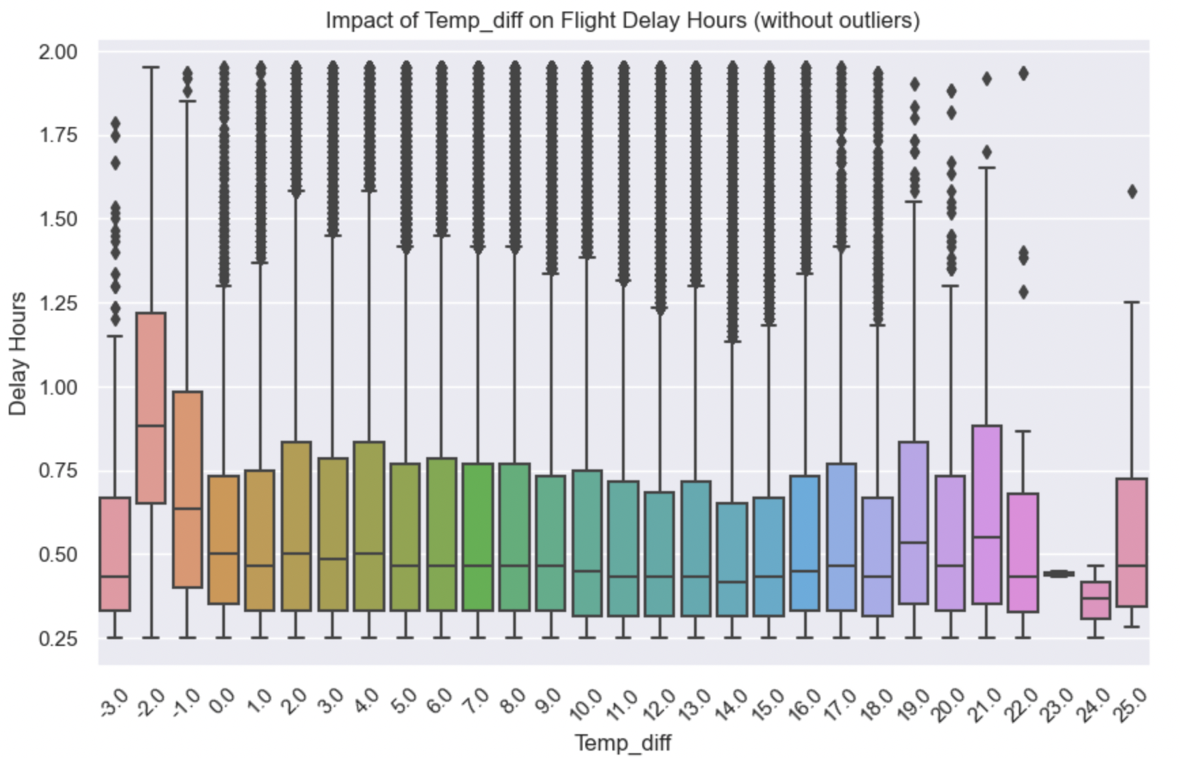
Impact of Temp_Diff on Flight Delays
Negative Temp_diff is outliers where Htemp is lower than LTemp
These outliers are removed in modelling

Slide 24
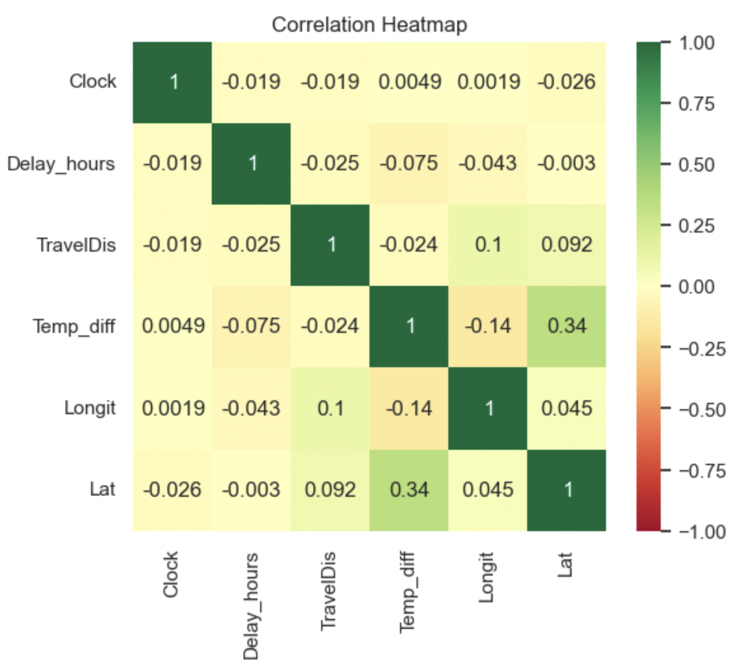
Correlation Heatmap on Independent Variables
Negative correlation in the correlation heatmap means there is a negative relationship or association between the variables being analysed.
Temp_diff vs Delay_hours: -0.075
Longit vs Delay_hours: -0.043
TravelDis vs Delay_hours: -0.025
Clock vs Delay_hours: -0.019
Highest negative correlation between Temp_Diff and Delay_hours.
Notes:
However, the magnitude of the negative correlation for Temp_diff is the highest, suggesting that changing variable for Temp_diff has the greatest impact on changes for Delay_hours. This is followed by Longit (-0.043) which suggest that the variable Longit has more significant impact on changes in Delay_hours compared to the rest of the variables

Slide 25
BOARDING PASS
FLIGHT
Data Processing
B345
GATE
D8
SEAT
29E
Notes:
Now, I’m going to talk about data processing.

Slide 26
BOARDING PASS
Our Data is obtained from…
The XieCheng database of Chinese domestic flight in year
Raw data comprise of 20 datasets
Contain 1,048,574 different internal flights in China and the possible cause for delays
Our Data Source:
https://github.com/udacity/CN-Flight-Delay-Forecast/blob/master/FlightDelayForecast.ipynb
Notes:
Our dataset is sourced from the XieCheng database, which provides information on Chinese domestic flights. The raw data consists of 20 datasets, including over one million records of various domestic flights in China, along with potential factors contributing to delays.

Slide 27
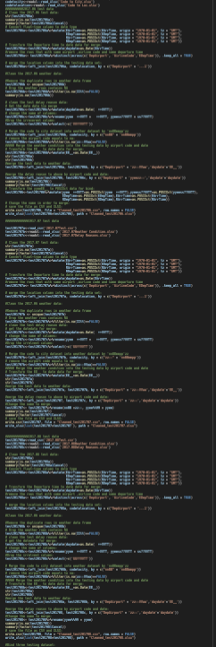
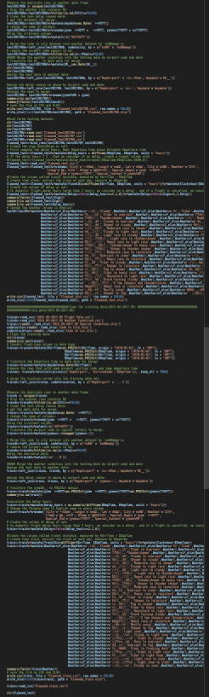
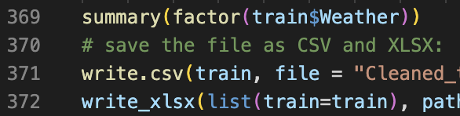
BOARDING PASS
Data Cleaning Process
Drop missing values
Remove outliers
Remove duplicates, etc.
Extraction and classification of the text data
Our Data Source:
https://github.com/udacity/CN-Flight-Delay-Forecast/blob/master/FlightDelayForecast.ipynb
Notes:
We merged the datasets, conducted data cleaning by removing NA values and outliers. Additionally, we extracted the text-based Weather information and translated it from Chinese to English. The Weather data was then restructured into 18 distinct categories.

Slide 28
Definition of Delay
$$Delay hours=Real Depart time−Esimate Depart time$$
Threshold: 2 Hours
> 2 hours
Delay Flight
Non-Delay Flight
Notes:
Our flight delay hours is defined as the $Real Departure time minus Esimate Departure time$; and we create dummy variable of delay signal, we set the threshold as 2 hours, which means the flight delay more than two hours are considered as real delay.

Slide 29
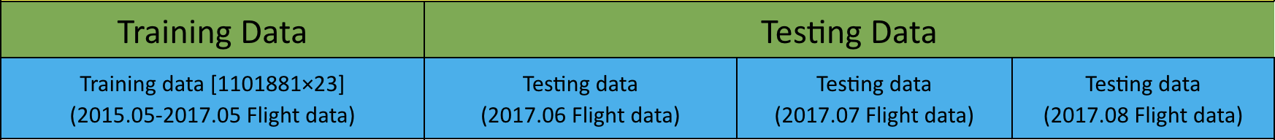
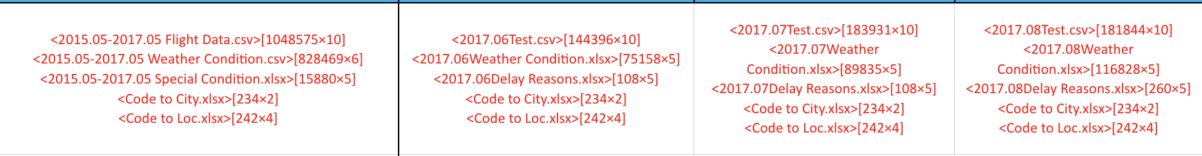
2015.12-2017.08 China Domestic Flight data
Merge & Cleaned into:
Cleaned_train [1101881]
Cleaned_test [535281]
Notes:
After merging and cleaning data, we proceeded to split the merged dataset into training and testing data.

Slide 30
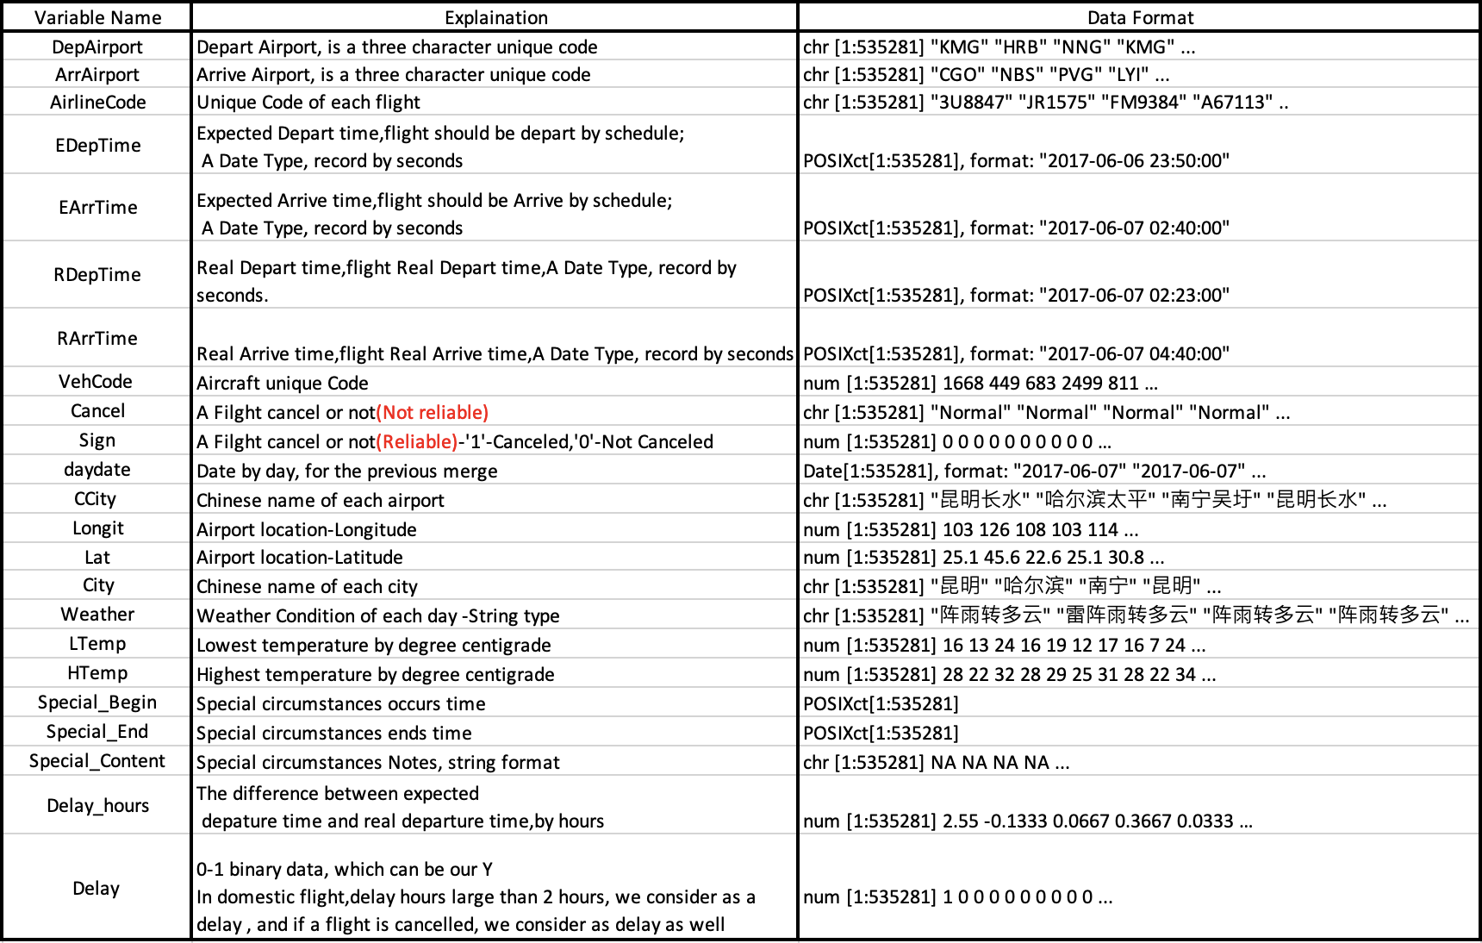
The dataset comprised of the following variables
Basically, can be classify as three main categories:
Flight Location
Weather & Temperatures
EARTH
Time of Flight
Earth is the third planet from the Sun and has life
Notes:
This table displays all the variables present in our cleaned dataset, which can be categorized into three main groups: flight location, weather and temperature, and time of flight.
Next, let's welcome Haoyang to present the modeling phase of our project.

Slide 31
MODELLING & PREDICTION
Feature importance
Prediction Accuracy
Notes:
During our in-depth analysis of the dataset, we have successfully examined the correlation between delayed flights and other relevant features. Additionally, our goal is dive more deep into the feature importance to develop in a predictive model that can forecast flight delays for the upcoming three months.

Slide 32
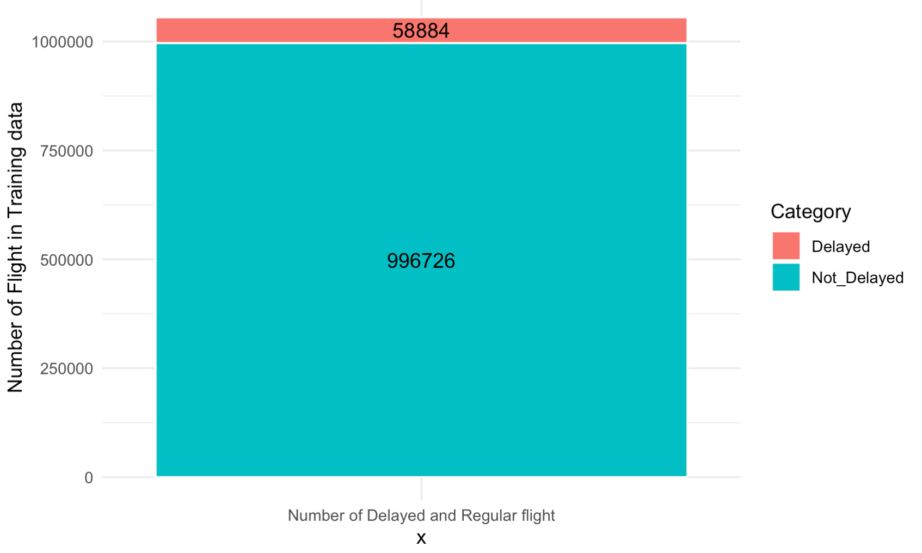
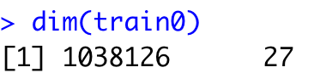
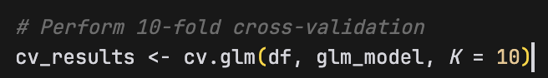
Before the modelling….
Unbalanced Data- SMOTE
K folds , n=10
Notes:
Before proceeding with the modeling phase, it is important to highlight certain aspects of the data. Firstly, we observe that the composition of delayed and not delayed flights is imbalanced, with only approximately 5% of flights experiencing delays. Under supervised learning, this could potentially introduce bias towards the majority class. To address this issue, we employ a resampling technique, specifically the SMOTE (Synthetic Minority Over-sampling Technique) method, which combines oversampling and undersampling to achieve a balanced representation of delayed and not delayed flights. This ensures that the model receives equal emphasis on both classes during training.
Furthermore, it is worth noting the substantial size of the dataset, with nearly 1 million data rows pertaining to flights. Considering the cross-validation process for the training dataset, we opt for a control method known as k-fold validation with n equals to 10. Due to the large volume of data, we do not employ LOOCV (Leave-One-Out Cross-Validation) or bootstrap methods, which could be computationally expensive.

Slide 33
MODELLING & PREDICTION
Feature importance
Geographic Weighted Regression(GWR)
On delay flight
Logistic Regression
Odds Probability
Prediction Accuracy
1.Logistic Regression
2. Random Forest
3. XGBoost
4. Support Vector Machine
Notes:
This is the outline of my part I will focus on this two aspect:
Importance of Features: I will emphasize the significance of identifying crucial features in our analysis. This will involve highlighting the variables that have a substantial impact on flight delays.and I will discuss the application of the GWR model, taking into account the geographical aspect. By incorporating location-specific factors, we can enhance the accuracy of our predictions and gain insights into spatial variations.
Odds Ratio in Logistic Regression: I will explain how the odds ratio serves as a critical criterion in logistic regression. This statistical measure will help us understand the effect of variables on flight delays, allowing us to assess their significance accurately.
Enhancing Prediction Accuracy: I will explore strategies to improve the prediction accuracy of our models. Specifically, I will focus on enhancing the performance of four key algorithms, enabling us to make more accurate predictions regarding flight delays.

Slide 34
Flight distribution & density of the China domestic flight
Flight Frequency
Delay Frequency
Notes:
As mentioned by my colleague earlier, the geographical location of flights, specifically latitude and longitude coordinates, may have a significant influence on flight outcomes. To investigate this further, I utilized the Google API to plot the density of flight frequency and the density of delayed flights across China.

Slide 35
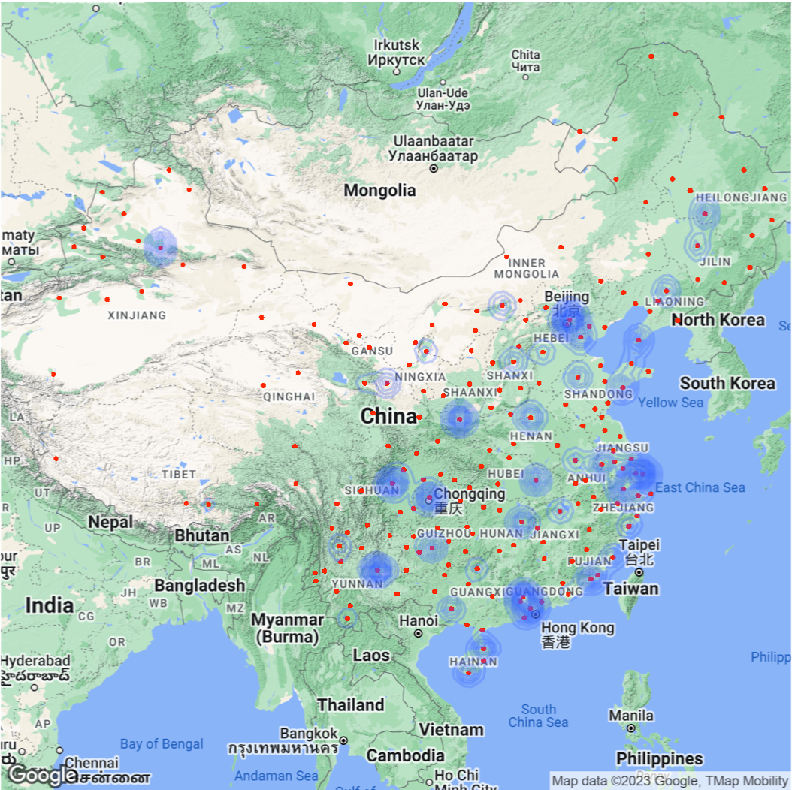
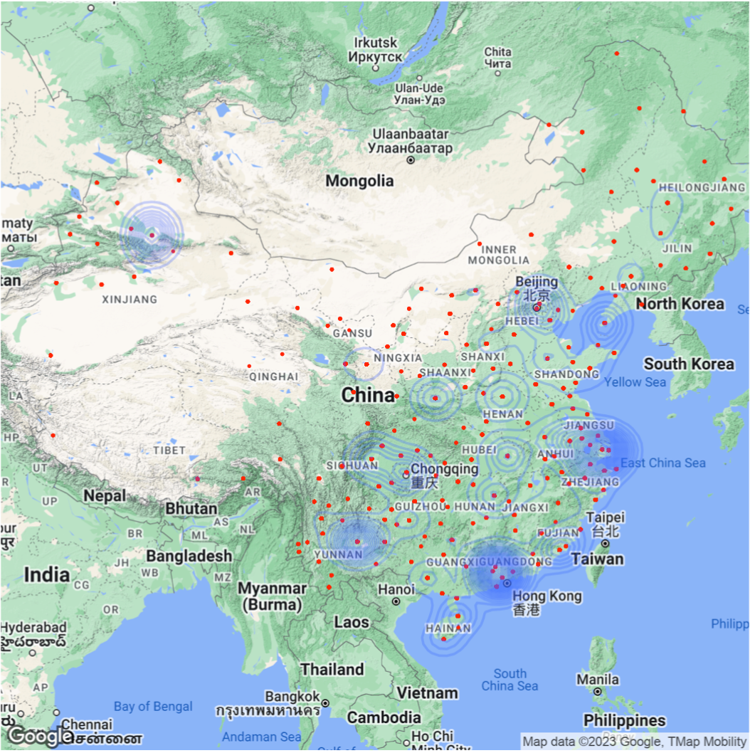
Flight distribution & density of the China domestic flight
Notes:
Through this spatial distribution visualization, we can observe key patterns. The airports are represented by red dots, while the blue circles indicate the frequency of flights, with varying shades denoting higher or lower frequencies. Similarly, on the right side, we can see the distribution of delayed flights based on location. Notably, we observe a concentration of flights in the northeast region of China. Given this observation, it is reasonable to assume that location indeed plays a role in the occurrence of flight delays.

Slide 36
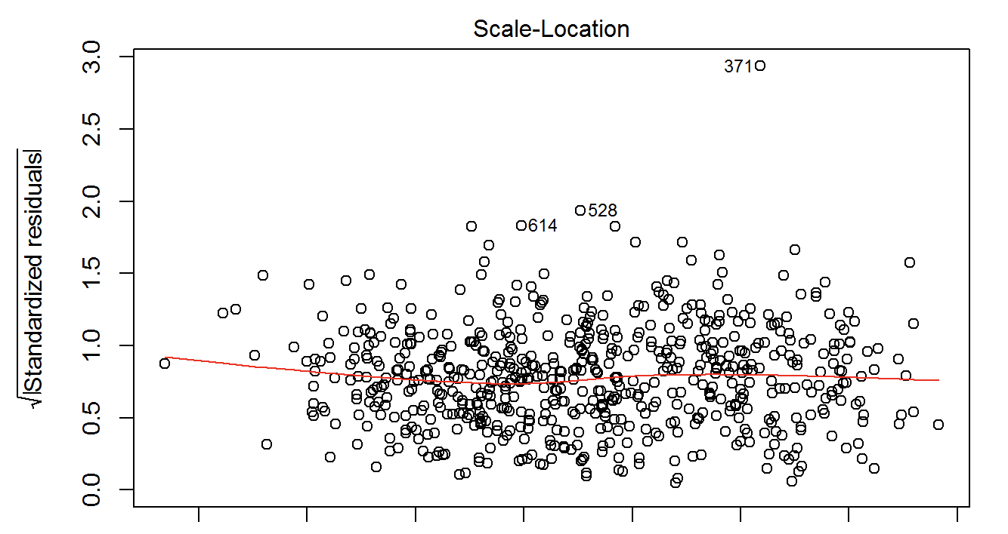
Notes:
So I preform Geographic weightage regression on the data, plot the residual plot of the scale location, unfortunately , the residual seems random distributed, which means the location did not effect the location based on this model;

Slide 37
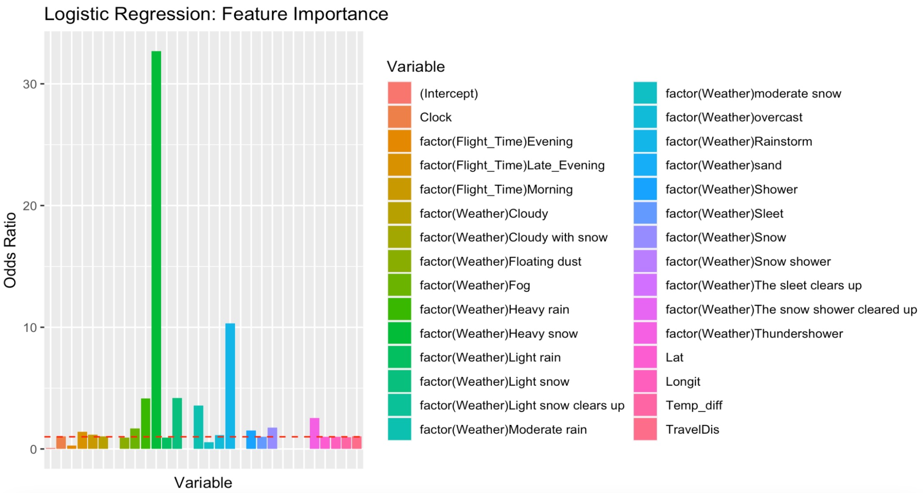
Impact of Variables on Flight Delays (Odds of delay)
Notes:
As for the feature importance , I take the odd ration of the logistic , the threshold below zero will have negative effecton the delay flight;

Slide 38
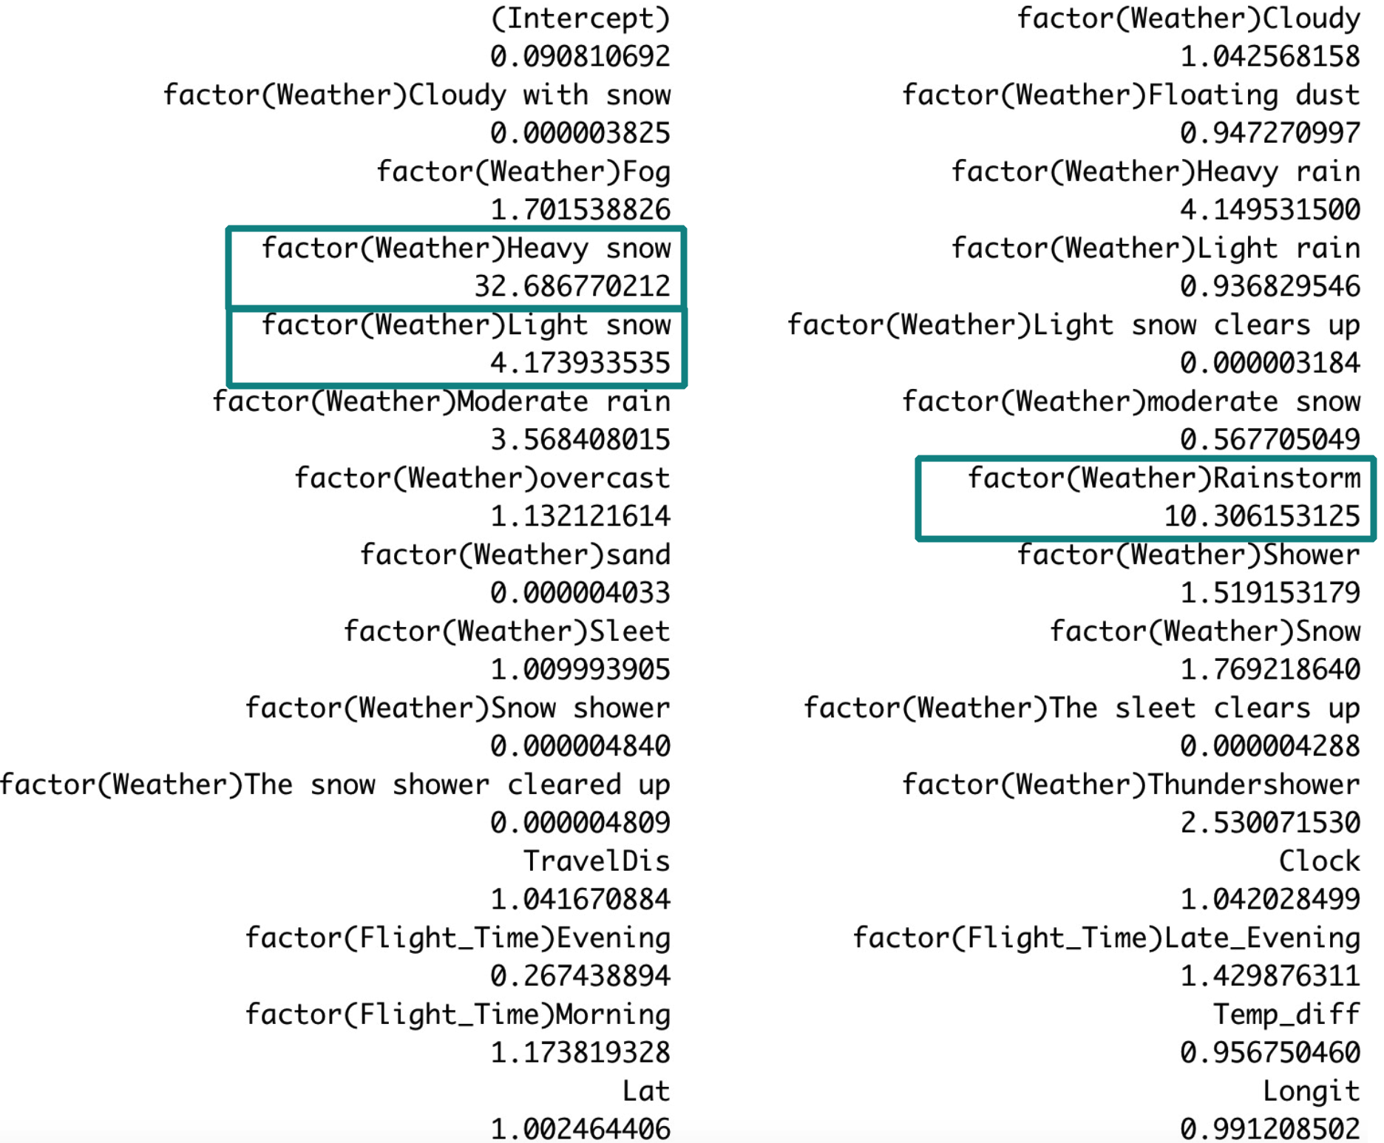
Odds of Features>1 – Significant to flight Delays
Notes:
This the slides highlight the top 3 odd ratio variables, all comes from the weather ,we can see that Heavy snow, light snow and rainstorm will cause significant influence on the flight delay

Slide 39

BOARDING PASS
Model selection for prediction:
Logistic Regression
Support Vector Machine
Random Forest
XGBoost
Notes:
After thorough evaluation, we have determined that classifier-based models, such as random forest and XGBoost, tend to perform better than traditional regression models when dealing with imbalanced data. Additionally, we take into account the risk of overfitting and, as a precaution, avoid utilizing more complex methods like neural networks or ensemble techniques. These advanced algorithms are not well-suited for datasets with small dimensions, and thus we opt for more suitable approaches given our specific data characteristics. finally our scope of method focus on for method,

Slide 40
Improve Prediction Accuracy – Parameter tuning
Random Forest
XGBoost
Criteria:
AUC (Area Under Curve)
Notes:
After we run these 4 algorithms, next things to do is to improve the prediction accuracy of these model, so next we tuning parameters o that, we basically focus on the tree method for tuning, which are random forest and XGBoost, the criteria we use for the prediction accuracy is AUC(are under ROC curve), the higher, the better.

Slide 41
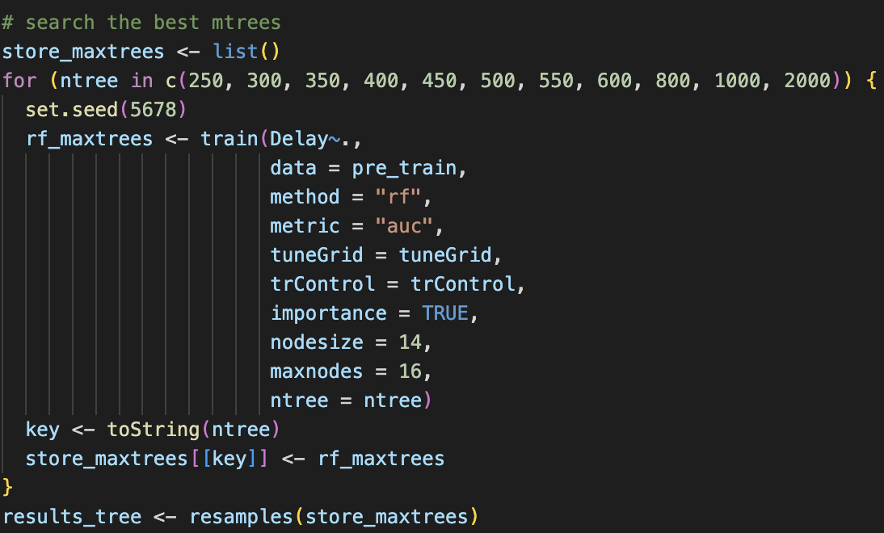
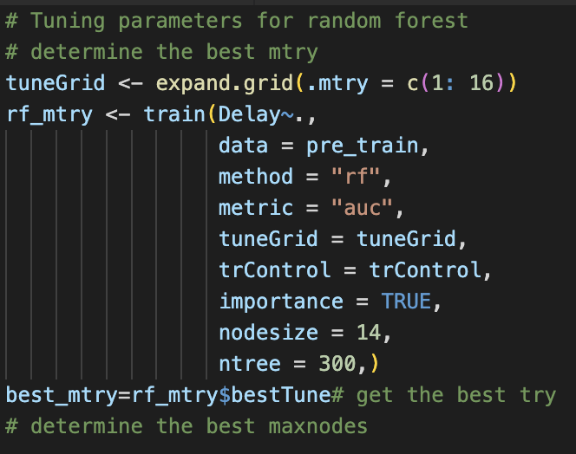
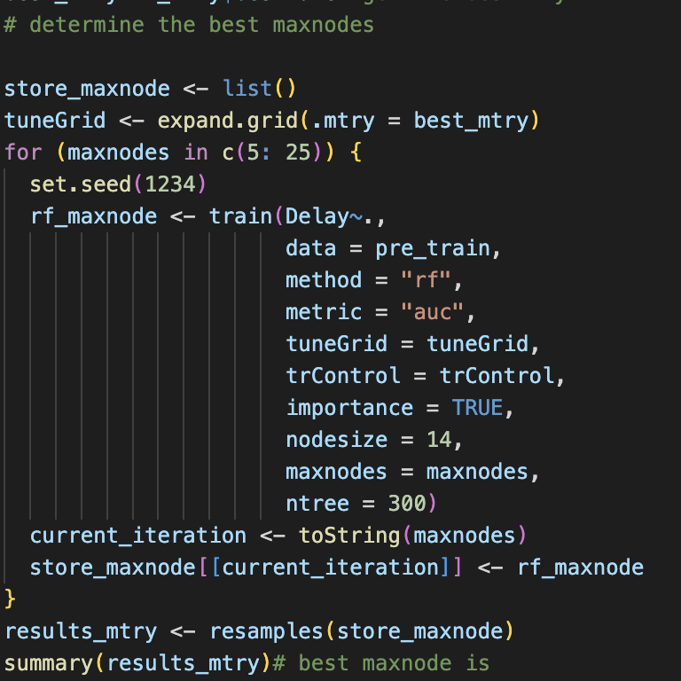
PARAMETERS TUNING
Random Forest
Notes:
(切）So for the tuning of random forest, I set a range of parameters to do the integration of three main parameters the best maximum try, (切）the max nodes and （切）the max trees;

Slide 42
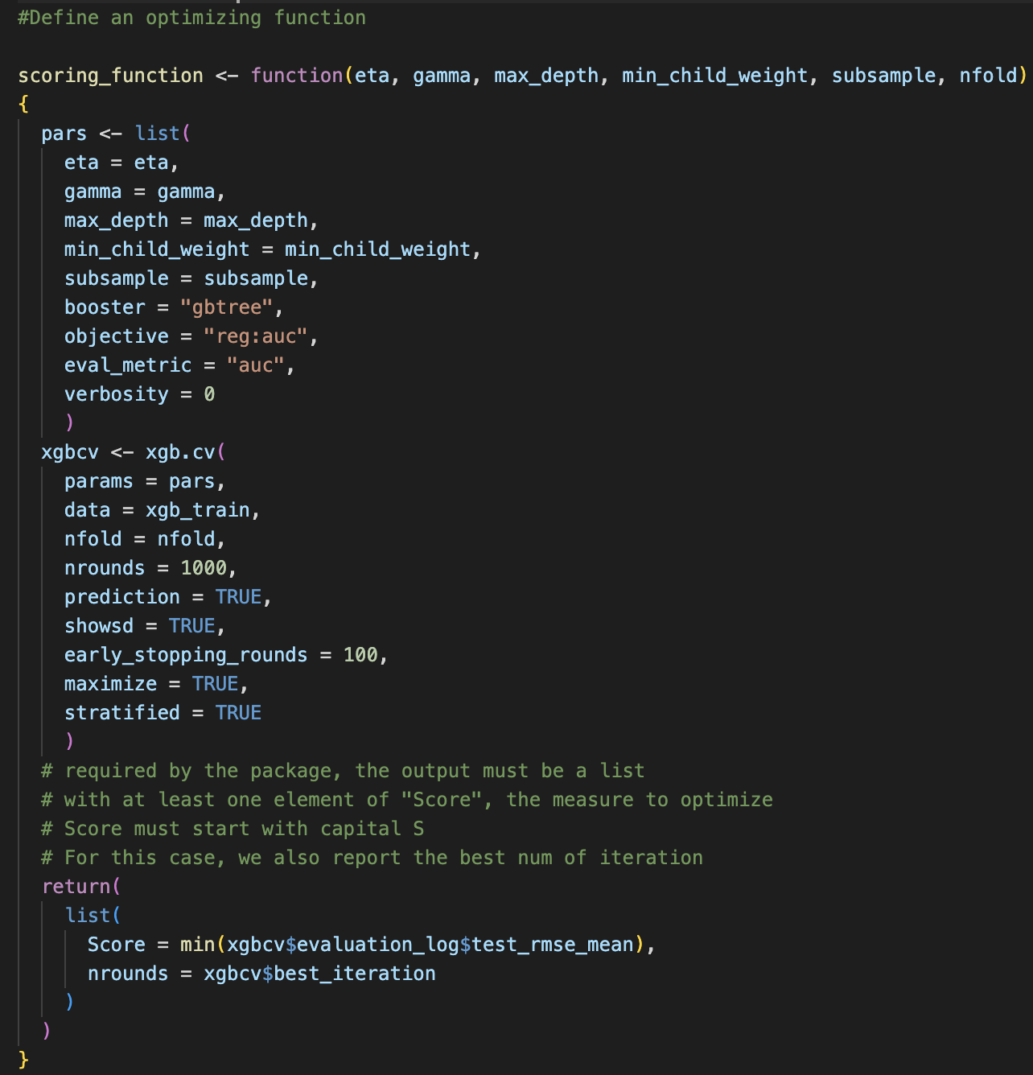
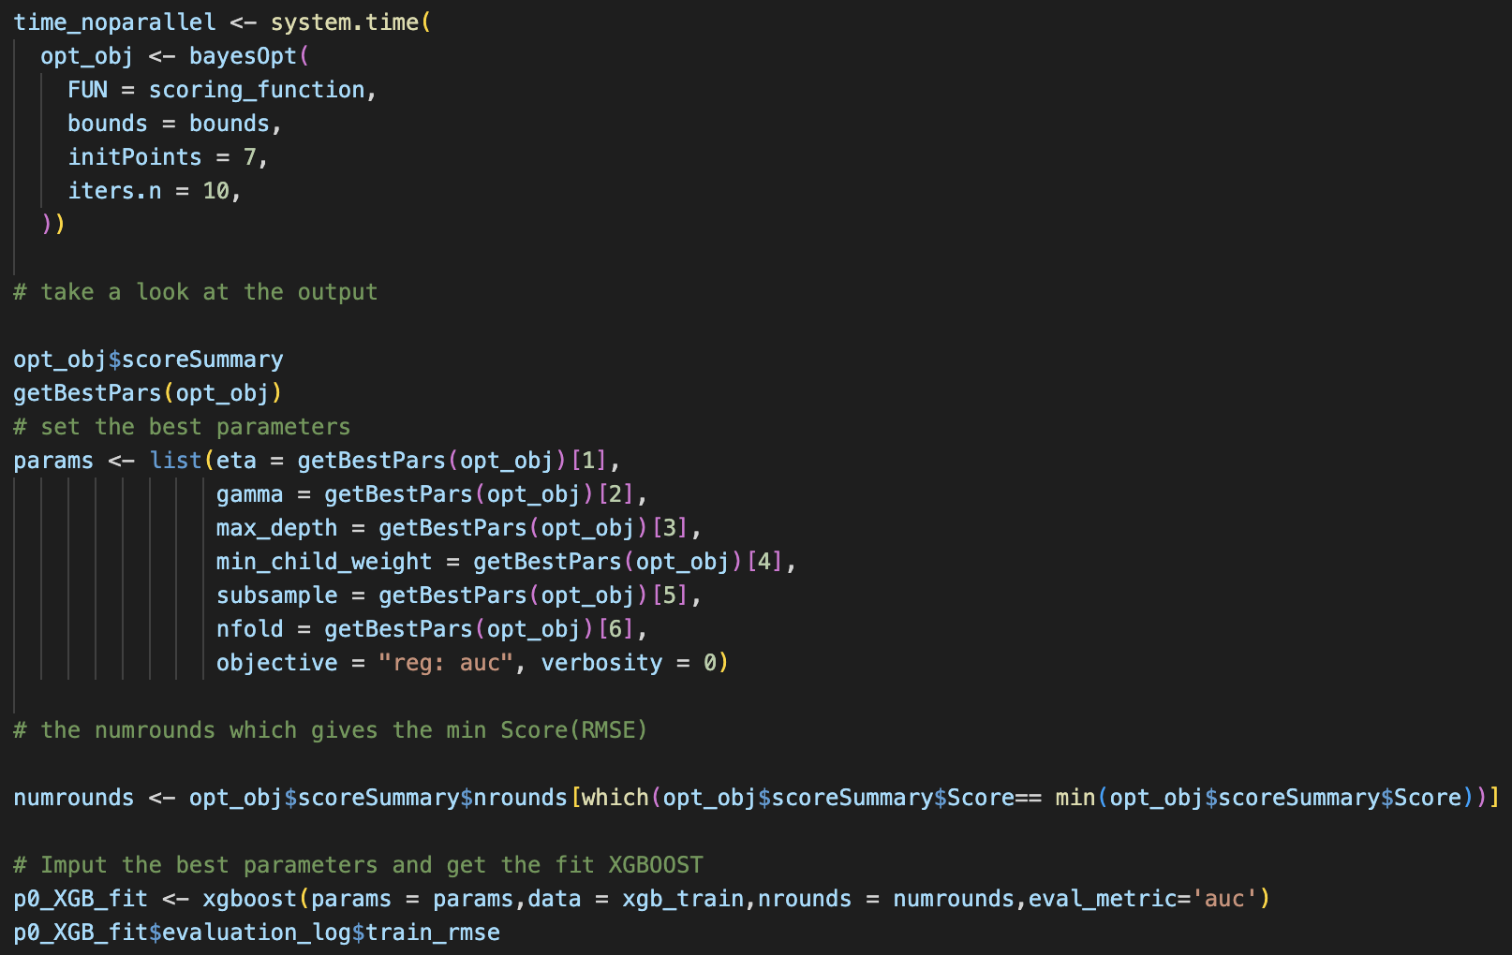
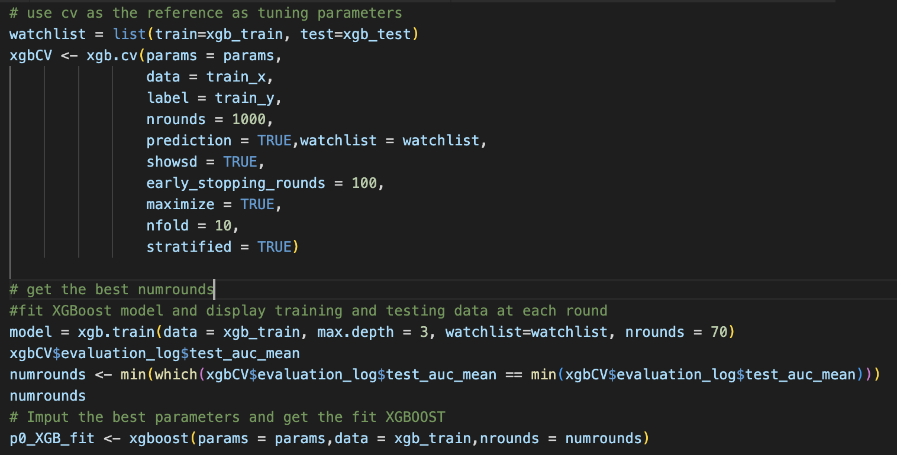
PARAMETERS TUNING
XGBoost
Simple Tuning
Comprehensive tuning(Bayesian optimization)
Notes:
Regarding the XGBoost method, I employed two distinct approaches for tuning the model. Firstly, I conducted simple tuning by iteratively adjusting the parameters. Secondly, I implemented comprehensive tuning using Bayesian Optimization. For the latter, I defined a Bayesian function and proceeded to store the best-performing parameters, including eta, gamma, max depth, min_child weight, subsample, and n-fold.
By utilizing these tuning methods, we aim to optimize the performance of the XGBoost model and identify the parameter combinations that yield the Highest AUC.

Slide 43
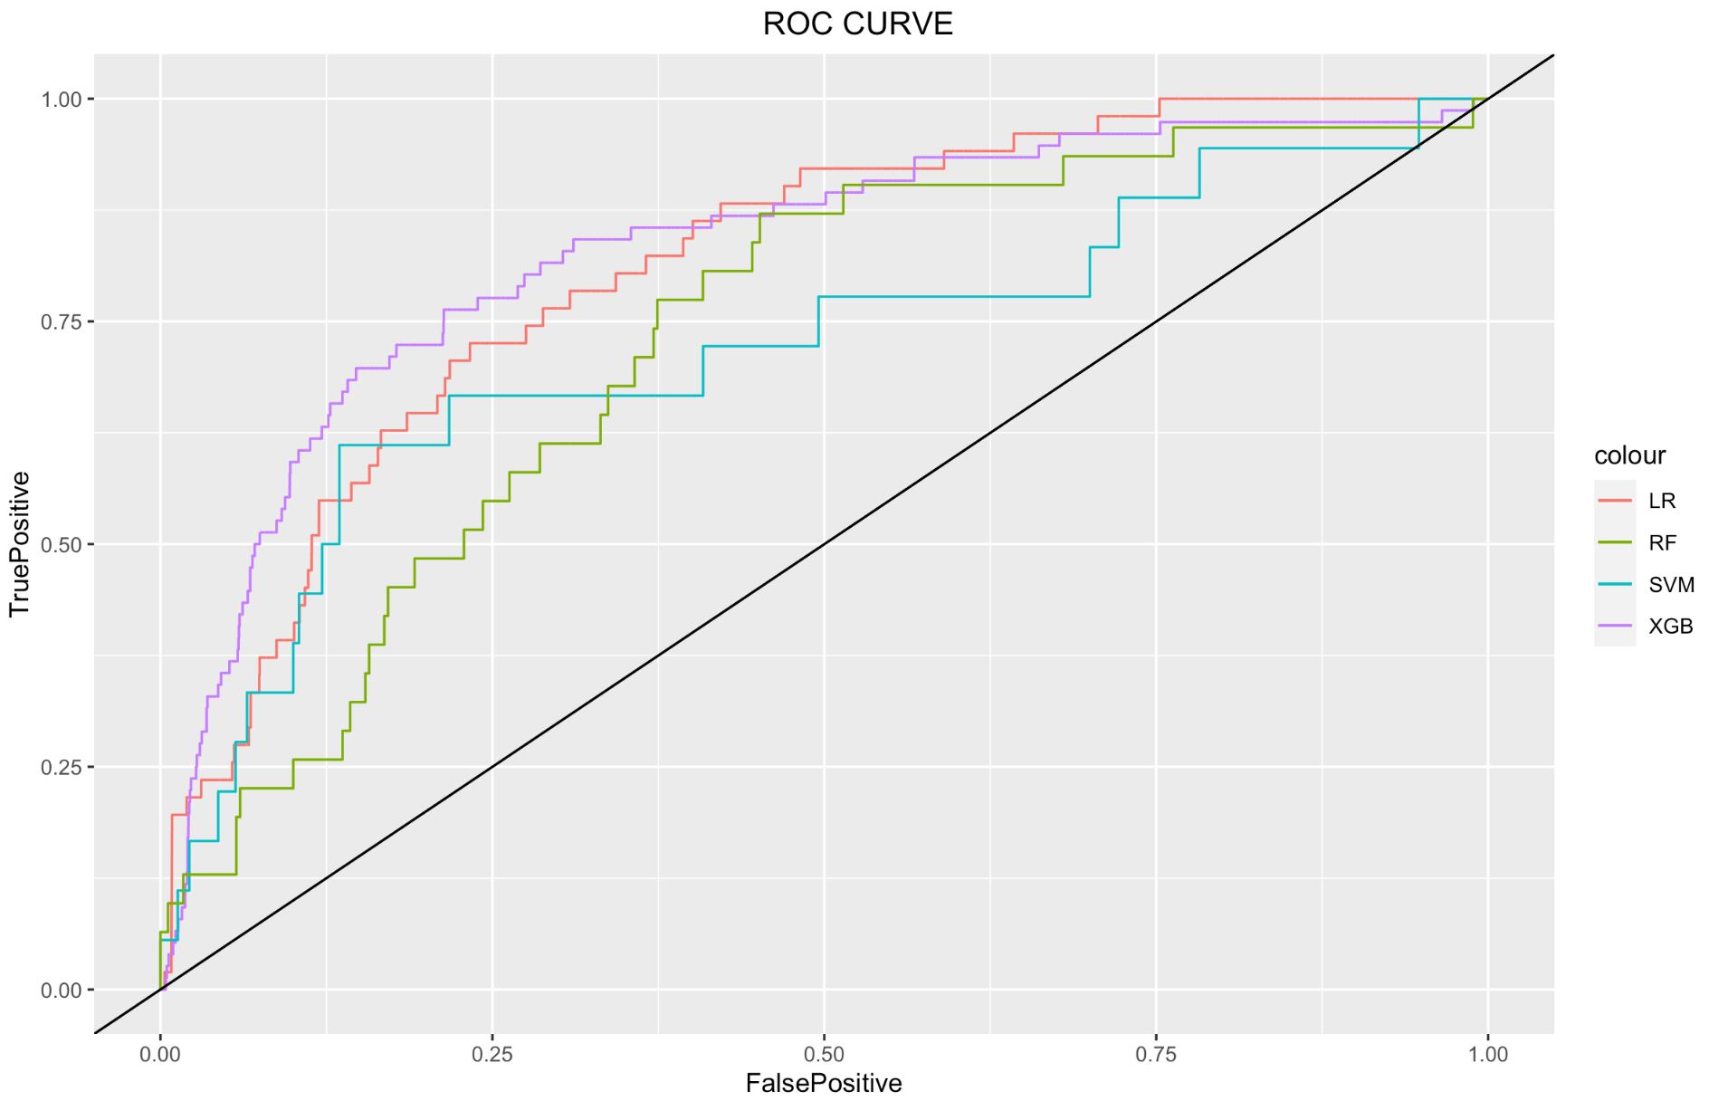
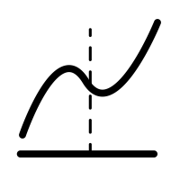



MODEL COMPARSION
Logistic Regression
0.8098
Support Vector Machine
0.6812
XGBoost
0.8281
Random Forest
0.7270
Notes:
Finally we at the stage of model comparison, this is the ROC curve of four fine tuned algorithms, we can observe that the XGBoost and Logistic regression has a relatively higher ROC curve which means the higher out of sample prediction accuracy with a AUC figure of 0.8098 of logistic regression and a AUC figure of 0.8281 of XGBoost., the thing surprised me is that the support vector machine does not proformed very well, only have a AUC figure of 0.6812 compares to the other three. I will hand over to yanrou for the last part.

Slide 44
BOARDING PASS
FLIGHT
Limitation & Conclusion
B345
GATE
D8
SEAT
29E
Notes:
After the tiresome of tuning parameter, we finally get the best result of four algorithms, besides, I also needs to talk about the limitation of our whole project.

Slide 45
Limitations of the Project
Did not consider much interaction between variables.(e.g., rainy combined with high latitude will cause more delay.)
The limited no of variables cannot explain the flight delay fully.
Shrinking of the text data of weather and drop a lot of information
Low Data Dimension
Cleaning of text data
Ignorance of Interaction effect
Data Reconstruction
Limitation of Resampling method
Defining of Flight Delay based on the delay hours is subjective.
LOCV (Leave-One-Cross-Validation) can be used for cross validation instead k-folds. Rebalance data.
Notes:
During our project, we encountered several limitations to consider. Firstly, the limited number of variables in our dataset may not fully explain flight delays. Secondly, defining delays solely based on hours can be subjective, impacting result accuracy. Additionally, text data cleaning may have resulted in information loss. Utilizing LOCV instead of k-folds for resampling may improve cross-validation and data balance. Lastly, our project did not extensively consider interaction effects between variables.

Slide 46
BOARDING PASS
CONCLUSION
FLIGHT
B345
GATE
D8
SEAT
29E
Application of machine learning in flight delay prediction
Utilized various machine learning models and evaluated performance using AUC
Improved accuracy and provided valuable insights
Enhancing travel experiences and operational efficiency
Notes:
In conclusion, our presentation emphasized the application of machine learning in predicting flight delays. Through the utilization of diverse models and AUC evaluation, we gained valuable insights into their effectiveness. Our findings highlight the potential of machine learning algorithms to enhance accuracy and provide valuable information for airlines, passengers, and stakeholders. The incorporation of machine learning in flight delay prediction holds great promise for enhancing travel experiences and operational efficiency in the aviation industry.

Slide 47


BOARDING PASS
FLIGHT
THANKS!
B345
GATE
D8
SEAT
29E
Do you have any questions?
Please keep this slide for attribution

